Slide 1
Watson Solution Patterns Overview Agent Assist
Business problem
Watson value proposition
Sample demo
Key client discussion points
Qualifying the client
Elevator pitch
Solution Architecture and Bill of Materials

Slide 2







Contact Centers are managing more channels, channel management is getting more complex and agent turnover is a growing concern for a number of clients
6B
2.5B
74%
81%
mobile devices world-wide; 1B+ of them smartphones
active Facebook, Twitter, and YouTube accounts
of Millennials believe technology makes life easier
say mobile is fundamentally changing how they do business
“You don’t know me”
Intolerance of mass-market, impersonalized approaches
“You make it too hard”
Expectations for immediate results
…and Customers are dissatisfied with channel experiences
“You’re not connecting with me”
Demand for interaction on channel of choice
Industries: Financial Services, Telecommunications, Energy & Utilities, Insurance, Airline, and Media companies

Slide 3




Watson’s Agent Assist pattern will drive contact center benefits on multiple levels and across various KPIs
Reduce Operating Cost | Improve Customer Satisfaction | Increase Opportunities To Sell | Reduce Customers At Risk
On average it takes 1.4 calls to resolve a customer problem
A 1% improvement in FCR = 1% improvement in customer satisfaction
When a customer call is resolved the customer cross-selling acceptance rate is increased by 20%
If the customer’s inquiry or problem is resolved in the first call, only 1% of those customers are at risk to go to your competitors
1
Quantitative KPIs
2
Qualitative Drivers
Lower AHT
Increase first call resolution
Decrease agent turnover
Better, more consistent customer service
Less requirements to train new employees
Correct and consistent answers

Slide 4
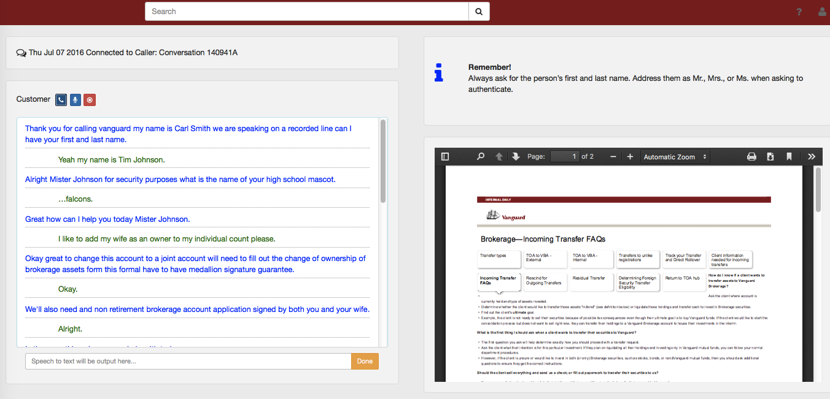
Agent Assist Demo
LIVE DEMO AND SCRIPT
URL: Agent Assist Demo
Watson/w@ts0n
Click: The Phone Icon near customer on right side of page to start the demo
Talking Points:
Watson is listening and transcribe the conversation between a customer and an agent.
Watson can understand the intent of the customers questions and can surface relevant information to the agent

Slide 5

Agent Assist Use Case
Use Case Theme
Description
Components
Users
Surface relevant content and data that is currently spread across multiple, disparate sources.
Provide end user (agents, CSR, technician, engineer, etc.) with 360º Customer view with relevant and timely information from multiple systems such as: outages, equipment status, billing, and transactional data, etc.
WEX
NLC and Dialog
Speech to Text
Text to Speech
SPSS
Streams
Contact Center Agents
Systems
Watson Explorer
Internal Knowledge
Dialog
SPSS
Field Notes
Virtual Assistant
Contact Center Agents
NLC
…
Collaboration Sources
Customer Data

Slide 6
A checklist for sellers to qualify the client
Key Criteria |  | Optimal Candidates Look Like:
SPONSORSHIP: |  | VP of Call centers and CRM leader are roles that have the best span of control to make the decisions that drive success with the clients C-suite engagement
VISION: |  | Understanding the impact of Watson technology and processes requires a bold vision, not an incremental one
BUDGET: |  | Being able to undertake a pilot is a great place but ensuring there is plan for broader roll-out up front drives faster adoption
METRICS: |  | Prioritized call center metrics and setting realistic goals of change & timeline
ADOPTION EFFORTS: |  | Understanding client processes and success definitions enable development of transformational processes and metrics
CUSTOMER EXPERIENCE: |  | A Watson-driven digital transformation combines channels seamlessly with shared metrics. Delivering these requires multiple domains working on shared platforms and information
BRAND REPUTATION: |  | Companies seeking to improve reputation or maintain leadership positions are better candidates. Success occurs when customer satisfaction and innovation are on executive agendas.

Slide 7
Elevator Pitch for Agent Assist
Watson can assist agent to make better decision with customers on the phone
Alert the agent based on the conversations with the customer
Provide relevant and personalized information to the agent at the point of contact
Provide a 360 view of the customer
Provide upsell opportunities based on insights
Emotional and social tones of the recorded conversation show the distribution of conversations across those categories from cognitive psychology
Can help with agent training
FAQs
What is the client buying?
A 1-year subscription to Watson Explorer license and Watson Developer Cloud Platform which will enable the client to develop the Social CRM pattern
How much does it generally cost and timeline?
$250K for 1-year subscription & 4 weeks to deploy an initial pilot
How does the solution get implemented?
There are two options:
Self-Serve: 1-week enablement session for client developers with education on the solution pattern. After which, client IT teams then develop/deploy the solution in a self-serve mode.
Professional Services: Hire IBM or use system integrator to develop

Slide 8
Start NOW. Continue with intense focus and deep passion for success.
1.
Target solutions for your accounts
Review materials
Solutions Card
Seller’s Brief
Demo + Script
Customize your messaging and materials
Prepare your pitch
Practice using the demos
2.
Determine your client customization
Determine which patterns work best
Request customized demos for solutions most relevant to industry and account (SC number needed)
Determine data and content sources
3.
Conduct your meeting with confidence
Effective, well rehearsed demos (video alternatives)
Direct, relevant slides
Ability to move quickly to sales process
And please be sure to give us your feedback!

Slide 9
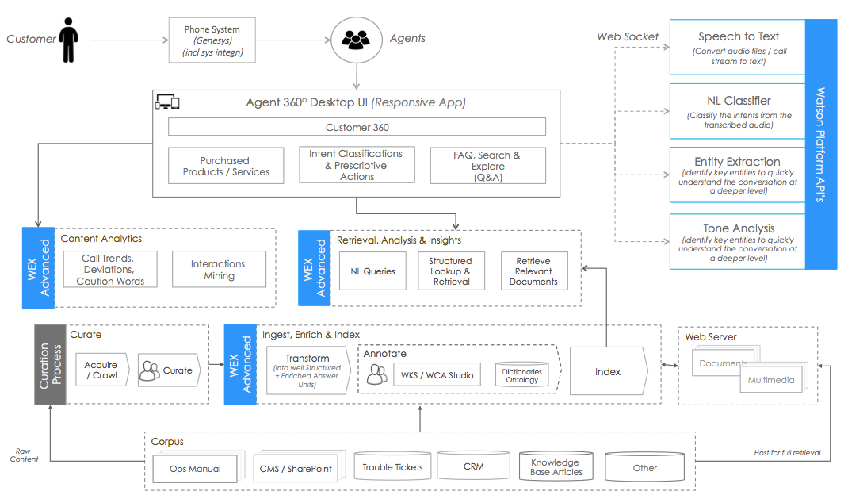
Solution Architecture and Bill of Materials
Watson Framework
WEX Advanced
WCA Studio
App Builder
Content Analytics
NLQ & Ontolections
WKS integrated with WEX Runtime
Watson Platform (Bluemix)
Natural Language Classifier
Speech to Text
AlchemyLanguage
Tone Analyzer
Other Bluemix
Cloudant
Insights for Twitter *

